Slide 1
AyeMerp
Arnold Tan
Nelson Ooi

Slide 2
Why AyeMerp?

Slide 3




Adam
Steve
Adam has a crush on Steve
Adam is unsure whether Steve likes him back
Adam fears:
outright rejection
feeling awkward after rejection
ruining his relationship with Steve
Out of fear, Adam chose not to confess his feelings :(
What if Steve actually likes Adam?

Slide 4
Let AyeMerp help Adam!

Slide 5

Adam
Steve
Middleman
“I <3 Steve!”
“I <3 Adam!”
AyeMerp
Notify both parties
Adam and Steve <3 each other!

Slide 6
Similar Apps in the Market

Slide 7


Down
Tinder

Slide 8
But AyeMerp is different

Slide 9
AyeMerp who?

Slide 10
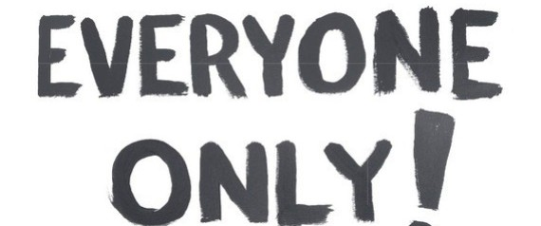

Slide 11
Co-workers
Adam
Steve
Middleman
“Our boss sucks”
“Our boss sucks”
AyeMerp
Notify both parties
Adam and Steve hate their boss!

Slide 12
Romantic Partners
Adam
Steve
Middleman
“Let’s have sex!”
“Let’s have sex”
AyeMerp
Notify both parties
Adam and Steve wants to have sex with each other!

Slide 13
AyeMerp
Merp is love. Merp is life.

